Slide 1
Algorithm 1 explanation

Slide 2
Sporadic Tasks: Online Convolutional approach
Convolutional refers to the computational approach used to determine whether the system can sustain schedulability.
The focus is on manipulating the unfinished work at any point in time. In the absence of faults, the unfinished work function consists of jumps when a task arrives, bringing new work, which are then worked off as the processor executes.
W(T ,t) denotes the unfinished work at time t due to task set T.

Slide 3

If we reckon time in discrete units of one (rather than as a continuous quantity), we can write a recursion for the unfinished work as follows:
where α(t + 1) is the amount of work, if any, brought in by a task arriving at time t + 1, we start things off with W(T , 0) = α(0).

Slide 4
W(T ,t + 1) denotes the unfinished work at time t+1 due to task set T
W(T ,t) denotes the unfinished work at time t due to task set T
α(t + 1) is the amount of work, if any, brought in by a task arriving at time t + 1.
(x)⁺ = x if x > 0, 0 otherwise
Means the expression (W(T ,t) − 1)⁺ indicates non-negative numbers.
Thus according to the previous expression the recursive formula defines that any term of a sequence in terms of its preceding term(s).
Thus unfinished work for the new task = previous unfinished work of the old task + work brought in by new task at time ‘t+1’.

Slide 5
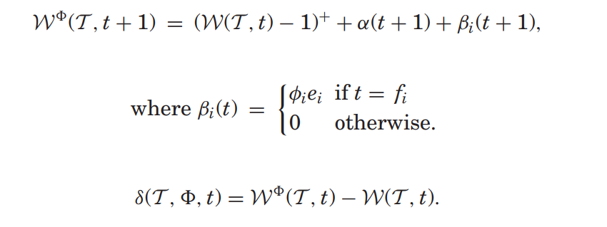
Let f_{i} denote the time when T_{i} completes execution if there are no faults. Now, consider the fault pattern = (φ₁,φ₂,...,φ_{n}), where φ_{i} is the number of faults that strike during execution of T_{i}, i = 1,..., n. Rather than condition this on when these failures actually occur, we “book” them for accounting purposes as if they all arrived at time f_{i} and that each failure of a given task imposes a load equal to the WCET of that task.

Slide 6
f_{i} = denote the time when T_{i} completes execution if there are no faults
fault pattern φ = (φ₁,φ₂,...,φ_{n}) where φ_{i} is the number of faults that strike during execution of T_{i}, i = 1,..., n. For example for task T₁ the fault is φ₁, For task T₂ the fault is φ₂ and so on.
W^{φ}(T ,t + 1) is the unfinished work at time t+1 due to task set T due to its fault pattern φ.
β_{i}(t)= φ_{i}e_{i} if t = f_{i}, 0 otherwise
where φ_{i}e_{i} = number of faults that strike during execution of T_{i} * execution time of task T_{i}

Slide 7
β_{i}(t + 1) means the amount of work done by task T_{i} considering the faults at time t+1.
Thus acc to the formula:
W^{φ}(T ,t + 1) = (W(T ,t) − 1)⁺ + α(t + 1) + β_{i}(t + 1) =>
The unfinished work for the task under the fault pattern φ at time ‘t+1’ = previous unfinished work of the old task + work brought in by new task at time ‘t+1’ + amount of work done by task T_{i} considering the faults at time t+1.

Slide 8
For the equation :
δ(T , φ , t) = W ^{φ}(T ,t) − W(T ,t).
It is the maximum additional unfinished work at time t due to running task set T and having been struck by φ failures/faults =>
unfinished work at time t due to task set T considering the fault pattern φ - unfinished work at time t due to task set T.
The above is also denoted by δ^{w}(T ,t) where w is the number of failures.

Slide 9
the algorithm is the observation that the lowest-priority task T_{l} ∈ T meets its deadline under the w-fault case if and only if δ^{w}(T ,t) = 0 for some t ∈ [f_{l,} D_{l} ]. [Where is the execution time for a particular task given no faults and is the deadline for that particular task.]
δ_{i}^{w}(T ) as the maximum additional work at time t = f_{i} caused by w faults that may strike any task executing in the interval [0, f_{i}]. We can now write the key recursion for δ_{i}^{w}(T ) (for convenience, we define δ₀^{w}(T ) = 0.)

Slide 10
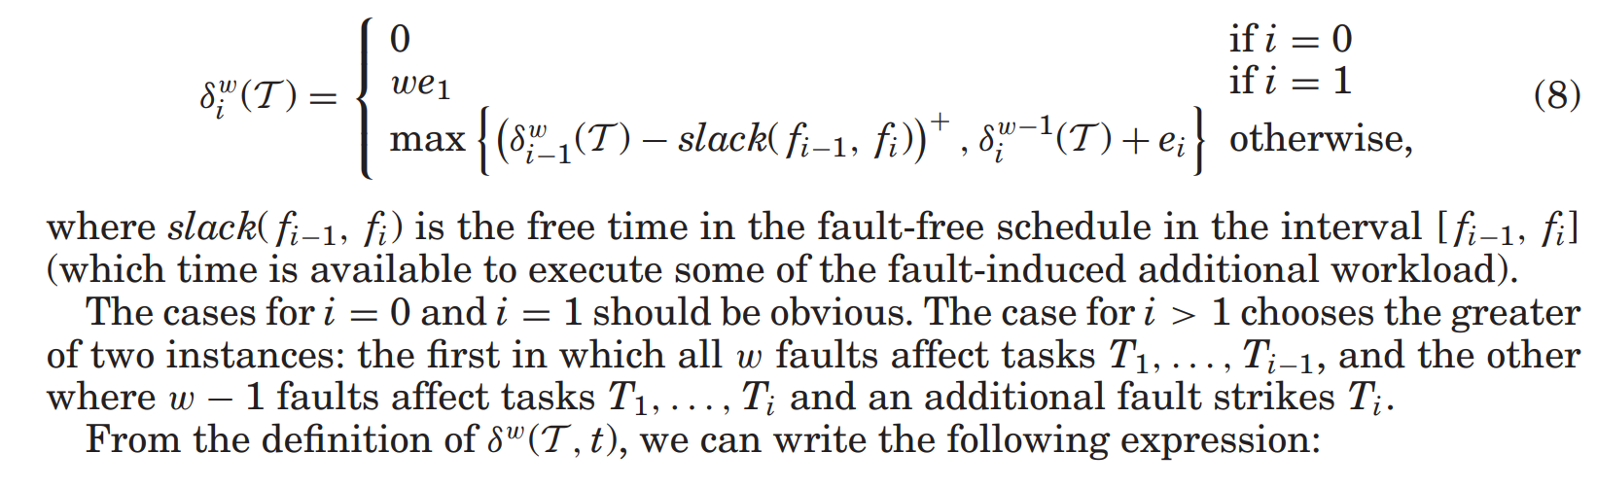

Slide 11
From the definition of δ^{w}(T ,t), we can write the following expression:
δ^{w}(T ,t) = δ_{i}^{w} (T ) − slack( f_{i},t) + , f_{i} ≤ t < f_{i}+1.
If T_{l} is the lowest-priority task in T and δ^{w}(T ,t) = 0 , we conclude that task T_{l} will meet its deadline despite the fault pattern F.

Slide 12
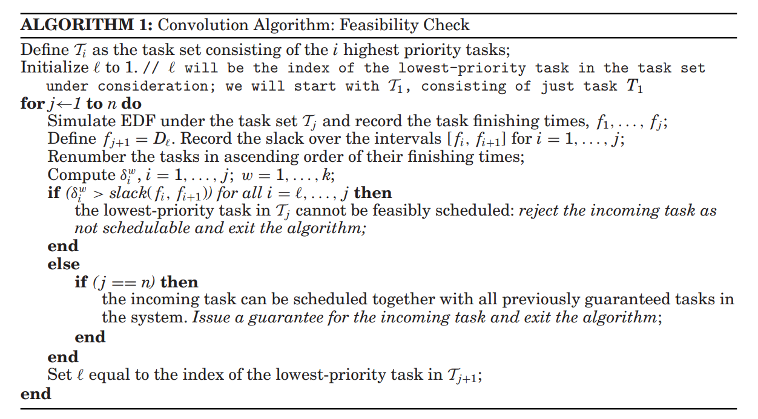
Convolution algorithm

Slide 13
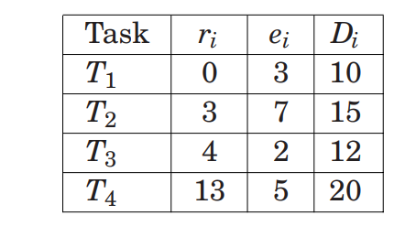
Example

Slide 14
Please follow pdf for example explanation

